Slide 1
Studio 5000
Function Block Diagram
© 2014 John Sefcovic

Slide 2
Function Block Diagram
Overview
Function Block Diagram programming uses instructions in a graphical format to connect the functions into procedures for the controlled application.
The instructions in Function Block Diagram programming are primarily used in event processes, analog process control, motion, and alarming.
Other programming instructions are included to allow the Function Block Diagram structures to be inclusive for the procedure being programmed.

Slide 3
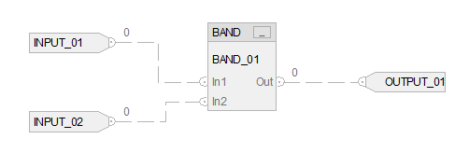
Function Block Diagram
Overview
A circuit is made up of Input and Output Reference instructions which are assigned to Controller or Program Tags.
Function Block Instructions are connected to the references to read in data and write out data from the Function Block Instruction. The Function Block Instructions have Parameters for the inputs and solved data. Some of the parameters are optional and can be deselected.
Connections are made by drawing lines between the “pins” on the instructions.

Slide 4
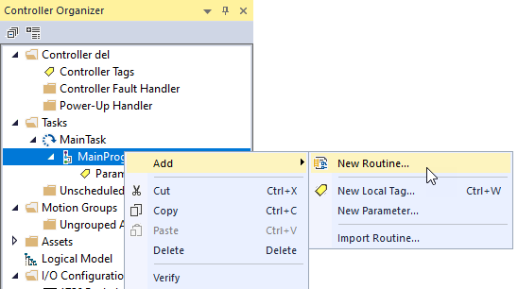
Function Block Diagram
New Function Block Routine
In the Controller Organizer, right click on a Program and select Add then New Routine.

Slide 5
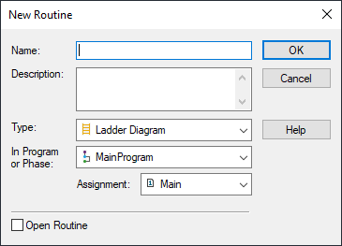
Function Block Diagram
New Function Block Routine
The New Routine dialog appears.

Slide 6
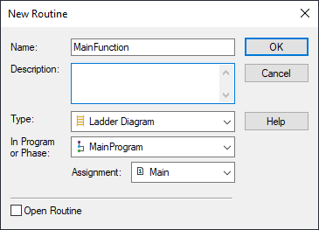
Function Block Diagram
New Function Block Routine
Enter a Name for the routine.
If subroutine label it

Slide 7
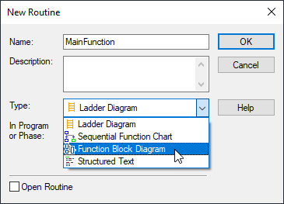
Function Block Diagram
New Function Block Routine
From the dropdown Type, select Function Block Diagram.

Slide 8
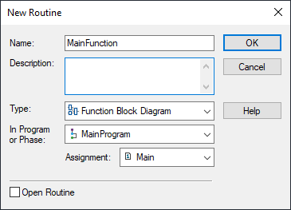
Function Block Diagram
New Function Block Routine
Select the OK button.

Slide 9
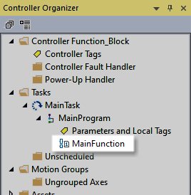
Function Block Diagram
New Function Block Routine
The named program will appear in the Project Tree.
Notice the icon for the Function Block Routine in the Controller Organizer.

Slide 10

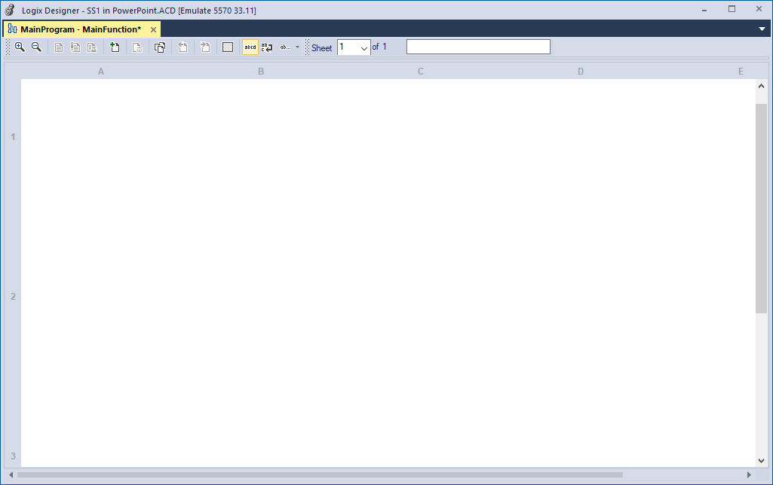
Function Block Diagram
Editor and Tool Bar
Instructions are dragged into the editor from the toolbar. Tabs organize the instructions.
The blank editor screen.

Slide 11




Function Block Diagram
Instructions
Two instructions are used to assign Tags to the function block instructions inputs and outputs.
Input Reference (IREF)
Output Reference (OREF)
Supply a value from an input device or tag, Boolean or Word.
Send a value to an output device or tag, Boolean or Word.
Tag assigned.
Tag assigned.

Slide 12




Function Block Diagram
Instructions
Bit or Boolean Tag have a “dot” at the connector.
A Word Tag is open.
Input Reference (IREF)
Output Reference (OREF)
Tag Data Type
Tag Data Type
Boolean Tag.
Boolean Tag.
Word Tag.
Word Tag.

Slide 13


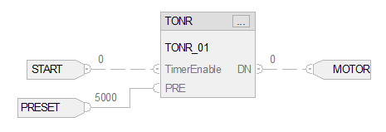
Function Block Diagram
Instructions
The connector line for Boolean data is a dashed line. Word data is a solid line.
Boolean Data.
Word Data.

Slide 14
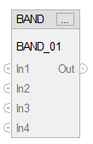
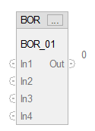
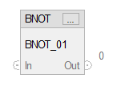
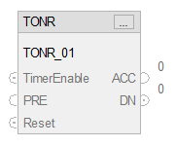
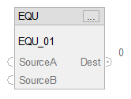
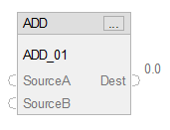
Function Block Diagram
Instructions
Binary AND
Various instruction function blocks can be selected to create the logic for the Function program.
Binary AND
Binary OR
Binary NOT
Timer ON
EQUAL
ADD

Slide 15
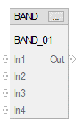
Function Block Diagram
Instructions
When an instruction is dragged onto the Editor a Tag Name is automatically created in the Parameter and Local Tags table.
Various instruction function blocks can be selected to create the logic for the Function program.
Binary AND
Binary OR
When an instruction is dragged onto the Editor a Tag Name is automatically created in the Parameter and Local Tags table.
The name will be the Instruction Type and Number of instance used, BAND_1.
The Tag may be renamed.
Binary NOT
Timer ON
EQUAL
ADD

Slide 16
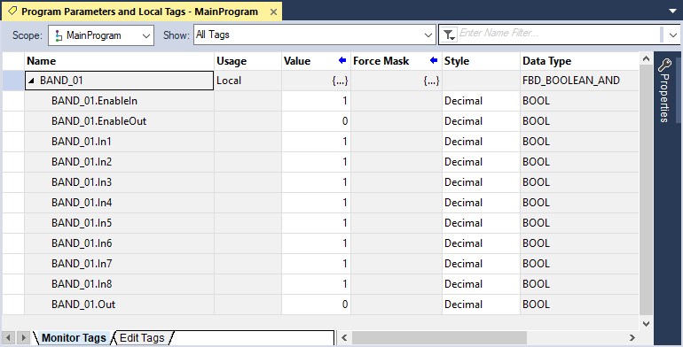
Function Block Diagram
Instructions
Tag BAND Instruction
The Tag Name is the same as the instruction.

Slide 17
Function Block Diagram
Instructions
created automatically
Tag BAND Instruction
The Data Type is FBD_BOOLEAN_AND.
Monitor tab you can view current value

Slide 18
Function Block Diagram
Instructions
Tag BAND Instruction
Instruction Parameter elements.
The In pins and Out pin.

Slide 19
Function Block Diagram
Instructions
Tag BAND Instruction
The value at the Tag element can be may be read or a value written to.

Slide 20
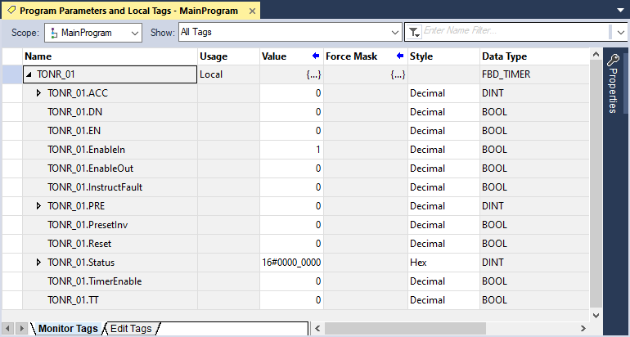
Function Block Diagram
Instructions
Tag TONR Instruction
The Tag Name is the same as the instruction.
The default Tag Name may be changed.
TONR_01.en - created auto
TONR_01.TimerEnable - Created auto

Slide 21
Function Block Diagram
Instructions
Tag TONR Instruction
The Data Type is FBD_TIMER.

Slide 22
Function Block Diagram
Instructions
Tag TONR Instruction
The instruction’s parameters are similar to the Ladder Logic and additional parameters for the Function Block Diagram Data Type.

Slide 23
Function Block Diagram
Instructions
NO TAG Name is automatically created for the IREF or OREF instruction.
The instruction uses the Tag Name assigned.
Input Reference (IREF)
Output Reference (OREF)

Slide 24


Function Block Diagram
Instructions
Normally Open with Output

Slide 25

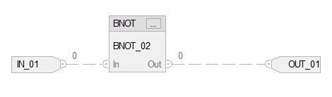
Function Block Diagram
Instructions
Normally Closed with Output
/ means not add a binary not instructino

Slide 26

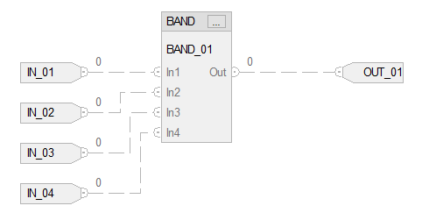
Function Block Diagram
Instructions
AND with Output
series

Slide 27
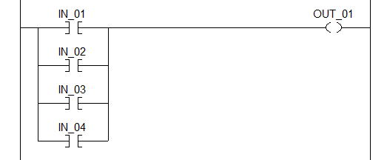
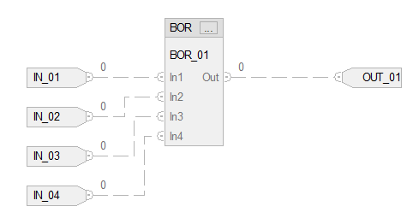
Function Block Diagram
Instructions
OR with Output

Slide 28
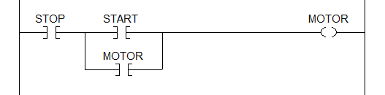
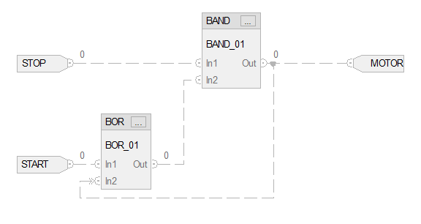
Function Block Diagram
Instructions
Example 1: STOP - START with Output

Slide 29
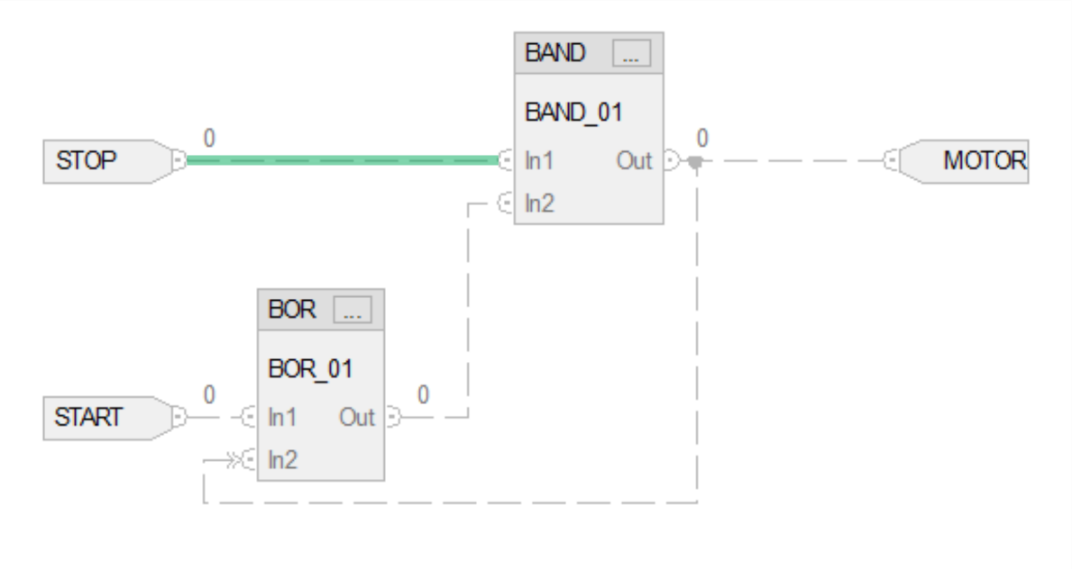
Function Block Diagram
Instructions
Example 1: STOP - START with Output
STOP is AND’d...
Power flow is added for clarification.

Slide 30
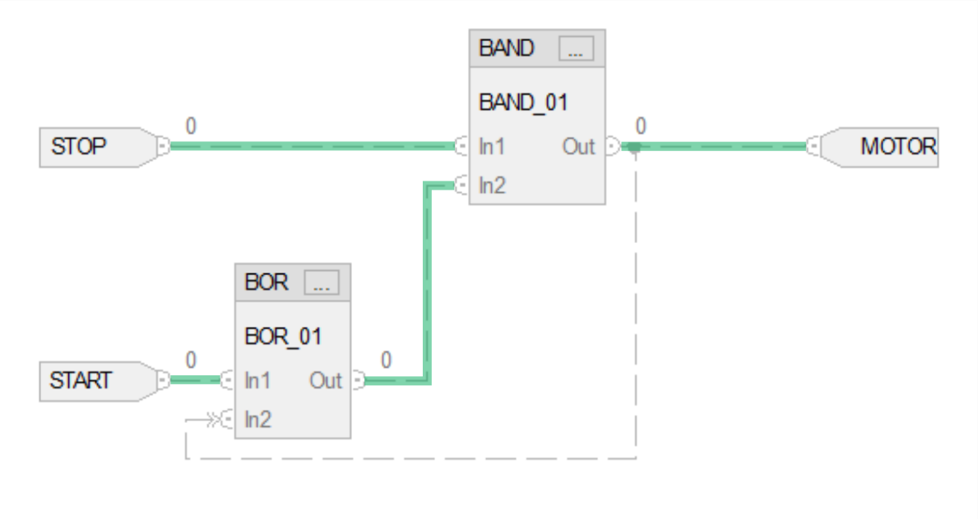
Function Block Diagram
Instructions
Example 1: STOP - START with Output
STOP is AND’d...
To energize the MOTOR.
…with START.
or - holding circuit
Power flow is added for clarification.

Slide 31
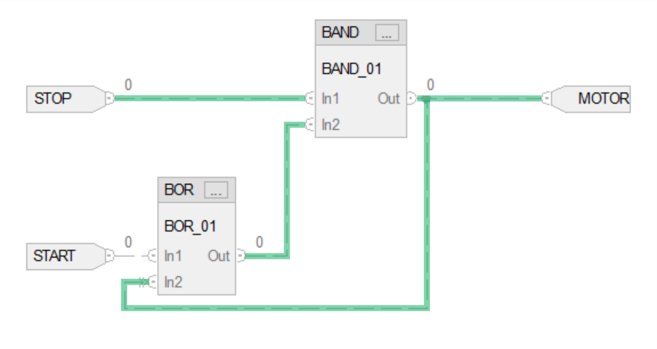
Function Block Diagram
Instructions
Example 1: STOP - START with Output
The OR’d energized MOTOR creates the Holding Circuit.
Power flow is added for clarification.

Slide 32
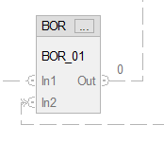
Function Block Diagram
Instructions
Example 1: STOP - START with Output
Because of the wrap around of the Holding Circuit from the Motor, the double arrows indicate it is assumed data will be present for the instruction when interpreted.
Right click on the Connection Line and select from the context menu, Assume Data.
wraps back around assume data

Slide 33
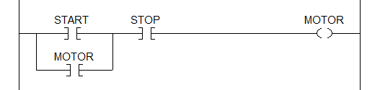
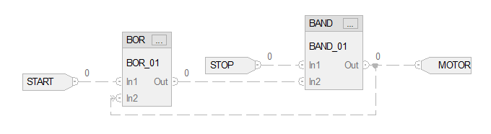
Function Block Diagram
Instructions
Example 2: STOP - START with Output
out same as motor
sometimes when open tries line to grid. Turn on grid align

Slide 34
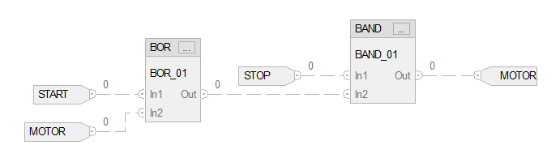
Function Block Diagram
Instructions
Example 3: STOP - START with Output
doesn’t look like a holding circuit still is

Slide 35
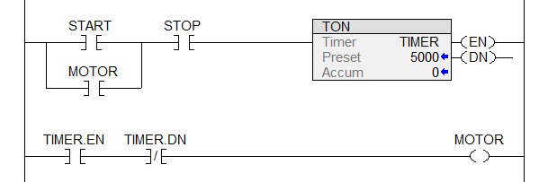
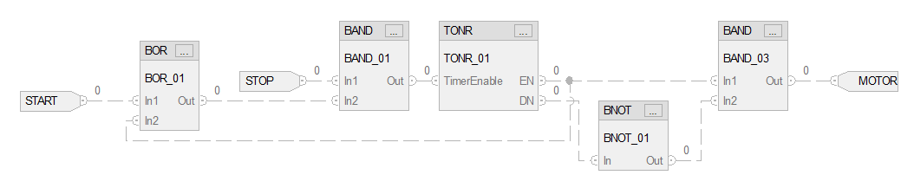
Function Block Diagram
Instructions
TIMER ON with Delay De-energize Output

Slide 36
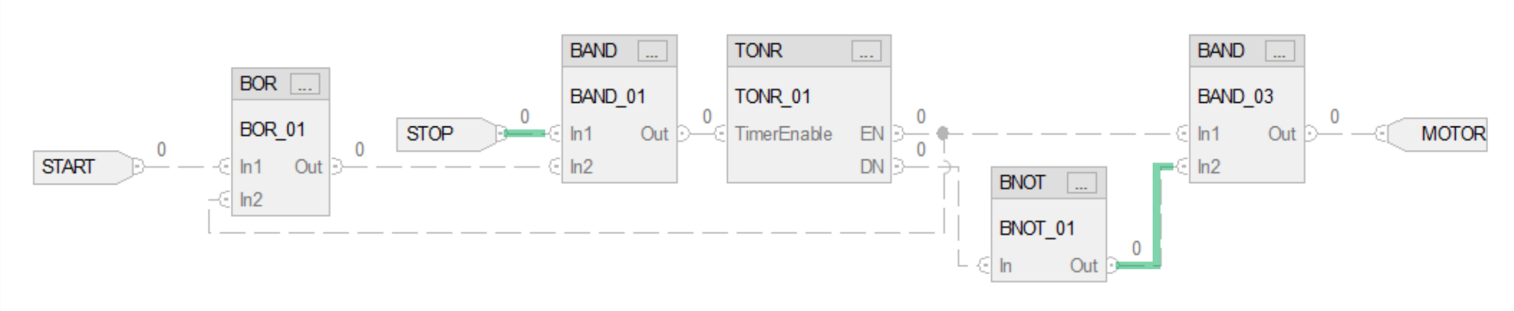
Function Block Diagram
Instructions
TIMER ON with Delay De-energize Output
Power flow is at the STOP pushbutton.
Power flow is added for clarification.

Slide 37
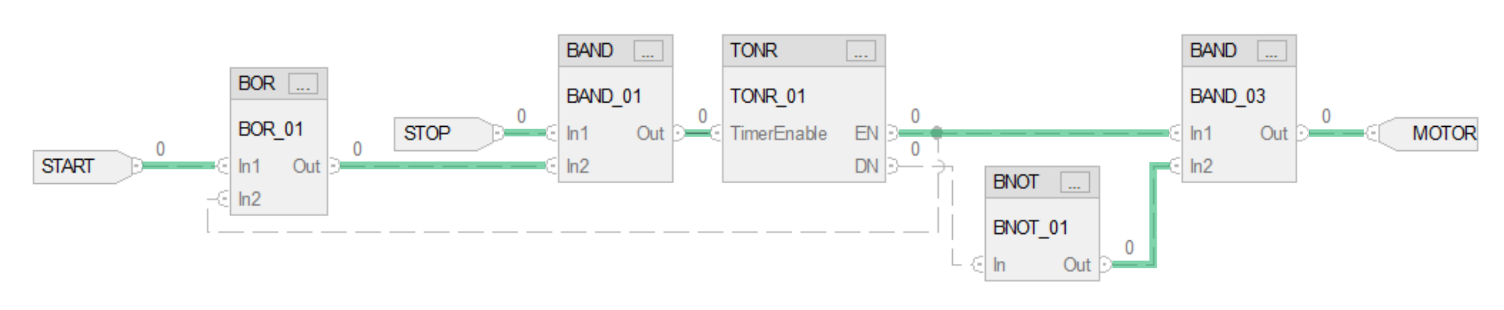
Function Block Diagram
Instructions
TIMER ON with Delay De-energize Output
The START pushbutton is pressed energizing the MOTOR.

Slide 38
Function Block Diagram
Instructions
TIMER ON with Delay De-energize Output
The TONR DN NOT’ed by the BNOT and provides power flow to the BAND for the MOTOR.

Slide 39
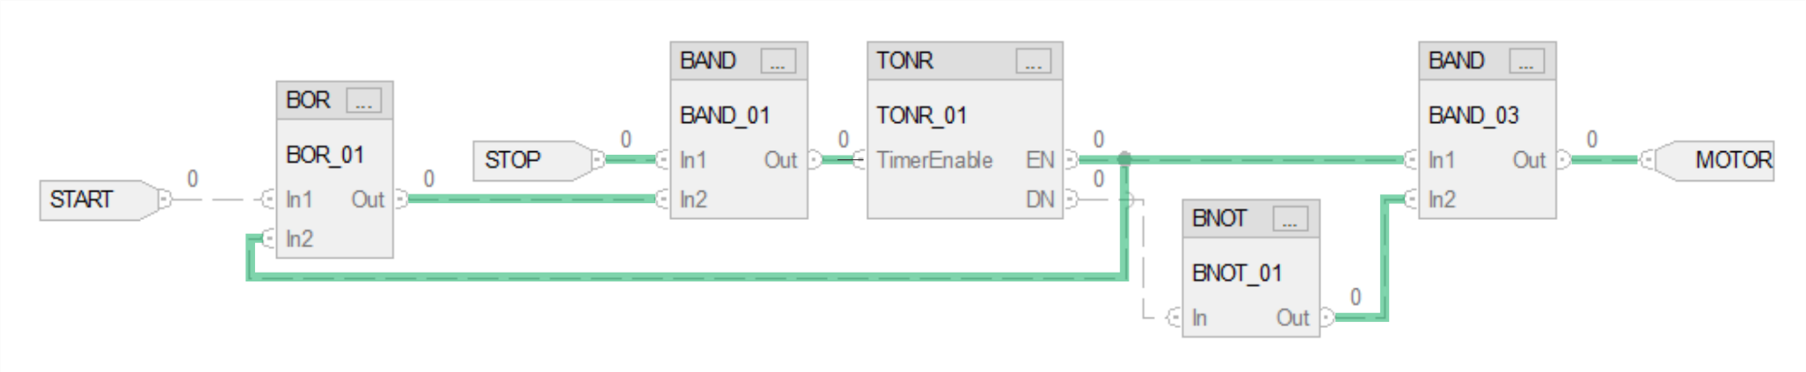
Function Block Diagram
Instructions
TIMER ON with Delay De-energize Output
The BOR’d “Holding Circuit” maintains power flow when START is released.
Power flow is added for clarification.

Slide 40
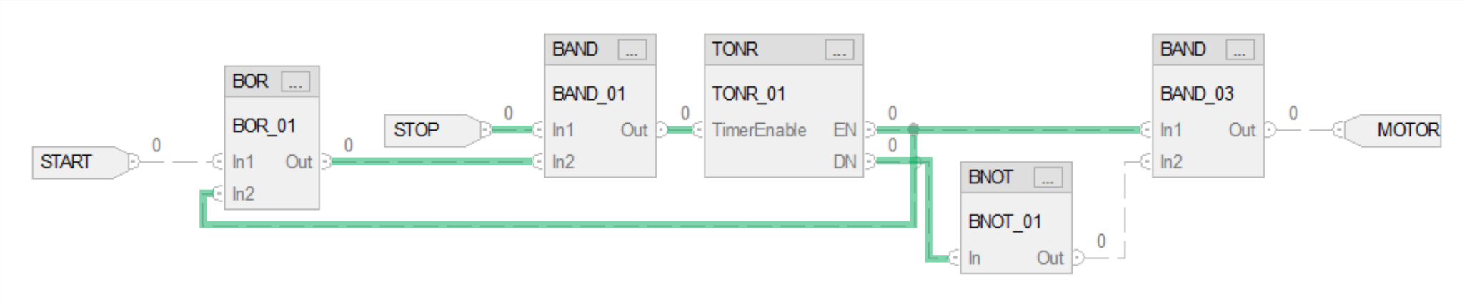
Function Block Diagram
Instructions
TIMER ON with Delay De-energize Output
The TONR times out and the DN is set, the BNOT discontinues power flow to the BAND and de-energizes the MOTOR.

Slide 41
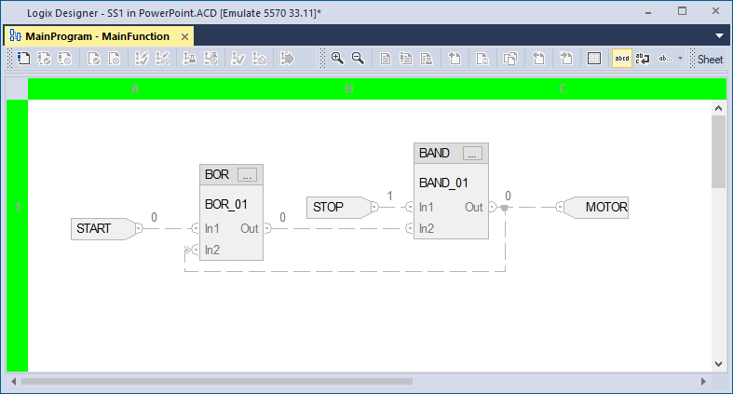
Function Block Diagram
Power Flow
Power flow is not graphically shown. The Tag value is shown at the instruction’s Pin.
START is Normally Open and shows a Logic 0.
STOP is Normally closed and shows a Logic 1.
The MOTOR is de-energized and shows a Logic 0.

Slide 42
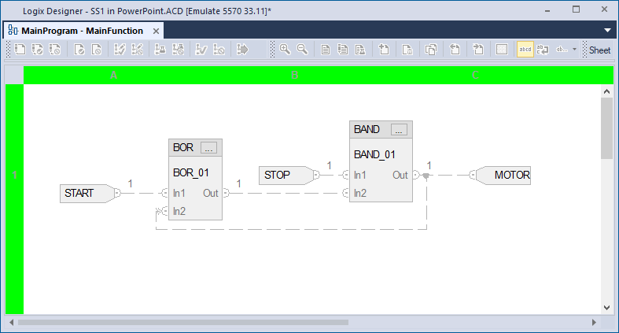
Function Block Diagram
Power Flow
START is pressed and shows a Logic 1.
The MOTOR is energized and shows a Logic 1.

Slide 43

Function Block Diagram
Power Flow
When START is released it returns to a Logic 0.
The MOTOR Logic 1 creates the “Holding Circuit” to the OR’d START.

Slide 44

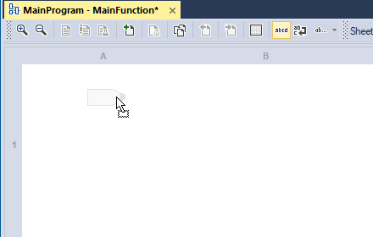
Function Block Diagram
Adding Instructions
Left click and Hold and drag the IREF input onto the editor
Careful oval and square look alot alike

Slide 45

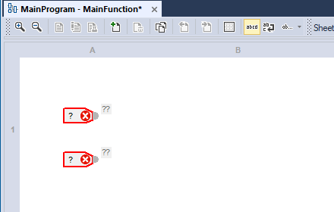
Function Block Diagram
Adding Instructions
In this example, two IREF inputs are dragged onto the editor

Slide 46
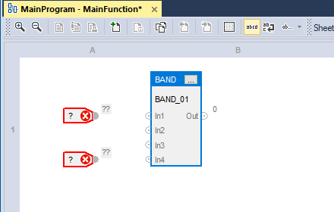
Function Block Diagram
Adding Instructions
The BAND instruction is dragged onto the editor.

Slide 47
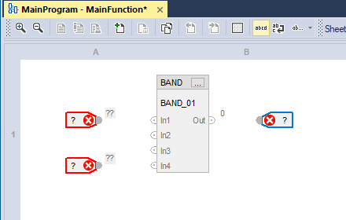
Function Block Diagram
Adding Instructions
Finally, the OREF output dragged onto the editor.

Slide 48
Function Block Diagram
Changing Instruction Parameters
Two inputs are used with the BAND.
Select the instruction’s Properties button.

Slide 49
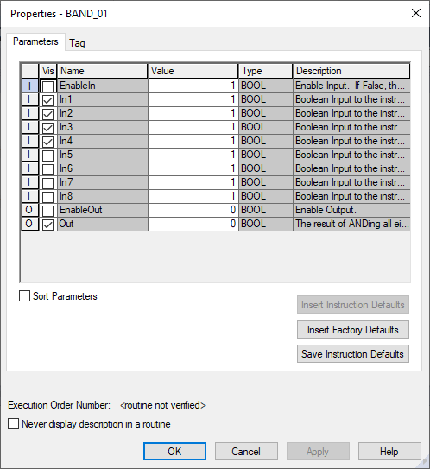
Function Block Diagram
Changing Instruction Parameters
The Properties dialog appears.
Uncheck In3 and In4.

Slide 50

Function Block Diagram
Changing Instruction Parameters
Uncheck In3 and In4.
Select OK to apply and close the properties dialog.

Slide 51
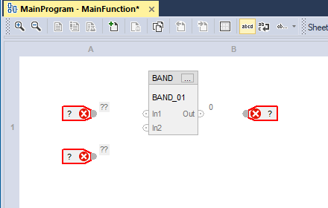
Function Block Diagram
Changing Instruction Parameters
In1 and In2 are visible and will be used as the input condition for the BAND logic.

Slide 52
Function Block Diagram
Assigning Tags
To assign a Tag to the instruction, double left click on the question mark (?). In this example, the top IREF instruction.

Slide 53
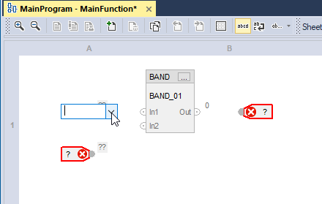
Function Block Diagram
Assigning Tags
A dropdown arrow field will appear, left click on the down arrowhead.

Slide 54
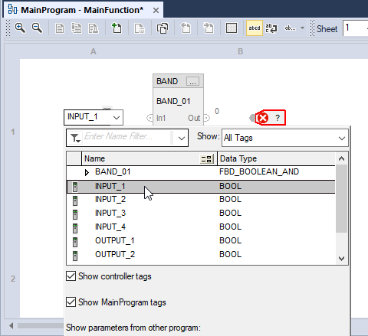
Function Block Diagram
Assigning Tags
From the Tag Selection dialog, left click on the Tag name.

Slide 55
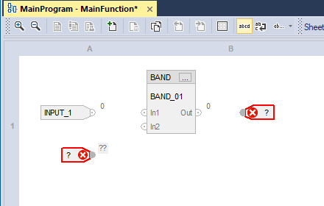
Function Block Diagram
Assigning Tags
The Tag name is assigned to the instruction.

Slide 56
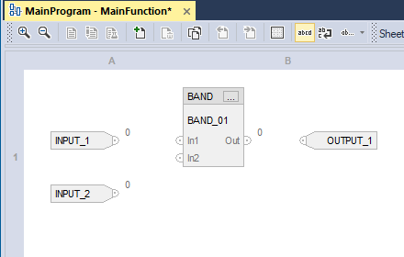
Function Block Diagram
Adding Connectors
Once, the Tags have been assigned, the connectors to the instruction’s pins are drawn.

Slide 57

Function Block Diagram
Adding Connectors
Left click and hold on the instruction’s pin. In this example the top IREF instruction.
A green marker appears and the cursor changes to the “draw” connection line.

Slide 58
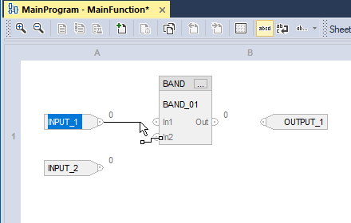
Function Block Diagram
Adding Connectors
While holding the left mouse button down, “drag” the connector to the other instructions pin.

Slide 59

Function Block Diagram
Adding Connectors
In this example the BAND In1 pin.
Notice the green marker at the In1 pin.

Slide 60

Function Block Diagram
Adding Connectors
Release the mouse button to set the connection.

Slide 61

Function Block Diagram
Adding Connectors
Complete the connections as required for the logic circuit.

Slide 62
Function Block Diagram
Sheets
To make it easier to navigate through a function block routine, divide the
routine into a series of sheets.
Sheets help in the organization and finding of the function blocks. They do not affect the order in which the function blocks execute.
In general, use one sheet for each device (motor, valve, solenoids) or programming function.
When the routine executes, all the sheets execute.

Slide 63




Function Block Diagram
Sheets
Execution of the “wired” function Block instructions are from left to right.

Slide 64


Function Block Diagram
Sheets
When there are multiple instruction levels on the sheet the execution is all left objects and then proceeds to the next right objects.
sweeps across the sheet all at once, function blocks watch out move instructions. Try one action per sheet better.

Slide 65

Function Block Diagram
Sheets Assume Data
This is why we make it assume data.
When the left to right sheet scan begins there is initially no data for the instruction’s second pin.

Slide 66
Function Block Diagram
Sheets Assume Data
The Assume Data must be assigned to the pin.

Slide 67

Function Block Diagram
Sheets Assume Data
The sheet scan is completed
As the left to right sheet scan continues the status of the signal for the first instruction pin is solved.

Slide 68

Function Block Diagram
Sheets Assume Data
On the next sheet scan cycle the data for the pin is present.

Slide 69

Function Block Diagram
Sheets
To add a sheet.
Select Add Sheet button.

Slide 70


Function Block Diagram
Sheets
To add a sheet.
A new sheet is added.

Slide 71
Function Block Diagram
Sheets
To delete a sheet.
Select Delete Sheet button.

Slide 72

Function Block Diagram
Sheets
To navigate to a sheet.
Select Previous or Next Sheet button.

Slide 73


Function Block Diagram
Sheets
To pass data between sheets, Input Connector (ICON) and Output Connectors (OCON) are used.
Ovals - Connectors
It’s how you pass information from one sheet to another.
Output Connector (OCON)
Input Connector (ICON)

Slide 74


Function Block Diagram
Sheets
To pass data between sheets, Input Connector (ICON) and Output Connectors (OCON) are used.
Output Connector (OCON)
Input Connector (ICON)

Slide 75
Function Block Diagram
Sheets
The text identifier for Input Connector (ICON) and Output Connectors (OCON) is not a controller or program tag.
Just text so you know what data you want to exchange between sheets
Output Connector (OCON)
The identifier for the connector is an instance used only by the sheets to pass data.
Input Connector (ICON)

Slide 76


Function Block Diagram
Sheets
SHEET 1
The result of the BAND on Sheet 1 is passed to the TONR enable on Sheet 2.
SHEET 2
The text below the connector is a cross-reference.
sheet-column row
Sheet number 2 row A column 1

